Slide 1
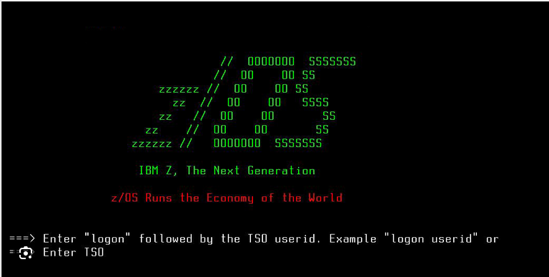

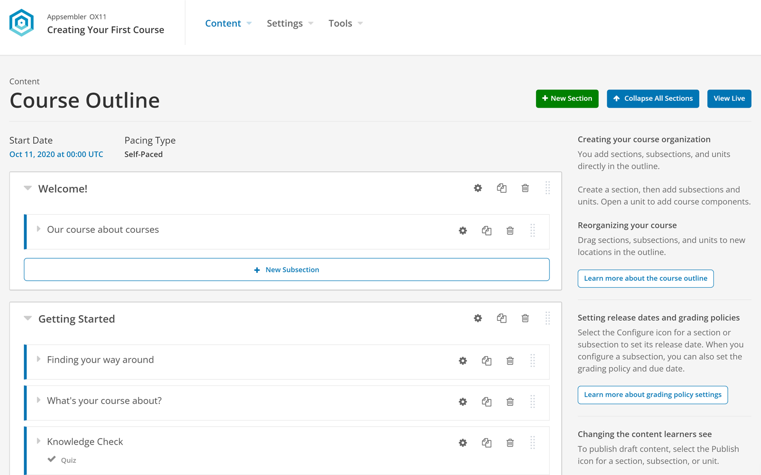
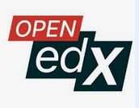
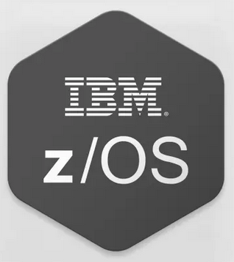
25-330
Mainframe Curriculum
Team members: Osman Zafar, Long Le, Arbab Arif Faculty adviser: Robert Dahlberg, Ph.D. Sponsor: Commonwealth Center for Advanced Computing
Problem Statement
Illustrations
Curriculum
Financial, government, retail, healthcare, logistics and insurance companies in the world use Mainframes
71% of Fortune 500 companies use them
70-80% of the world’s data and 90% of all credit card transactions
There is a severe lack of Mainframe talent to replace the current aging workforce with are retiring at accelerating rate
Continued existence of Mainframe dependent on maintaining skills in the workforce
General Concepts
Basic z/OS architecture
Interactive System Productivity Facility (ISPF)
System Display and Search Facility (SDSF)
TSO (Time Share Option)
Job Control Language (JCL)
Unix Systems Services (USS)
Methodology
Existing Solutions
Use Open edX – Open source LMS developed for online learning
Create small learning modules for online learning. Modules include interactive experiential learning techniques.
Users learn at their own pace and receive digital certifications once successfully complete course.
IBM Z Xplorer Certification – not reflective of industry usage
IBM Skills certification – hard to find and confusing
A few Universities have Mainframe courses: @ 7 universities in US
Social Value
Next Steps
Support more environmentally friendly system
70% more energy efficiency
75% less heat production
Support 70% smaller footprint
Support a higher efficient system
99.999% more reliable
Never been hacked – Quantum Safe
Review and integrate with Bank of America, East Carolina University, and Northern Illinois University
Integrate labs on the z/16 into the learning modules

